Slide 2
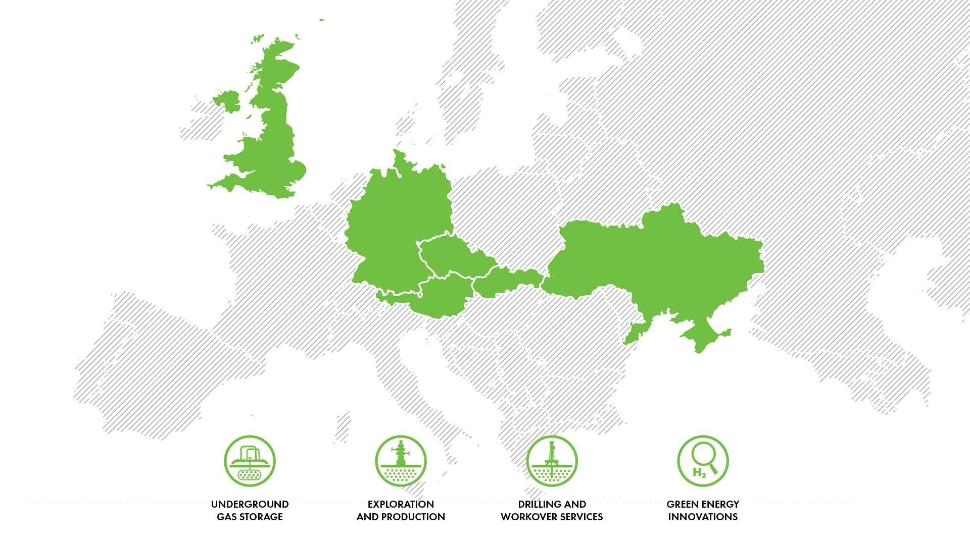
NAFTA in europe

Slide 3
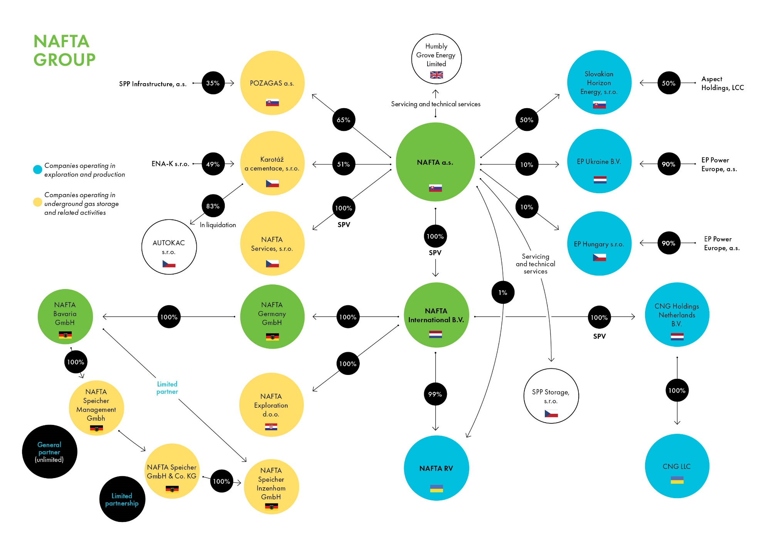

Slide 4
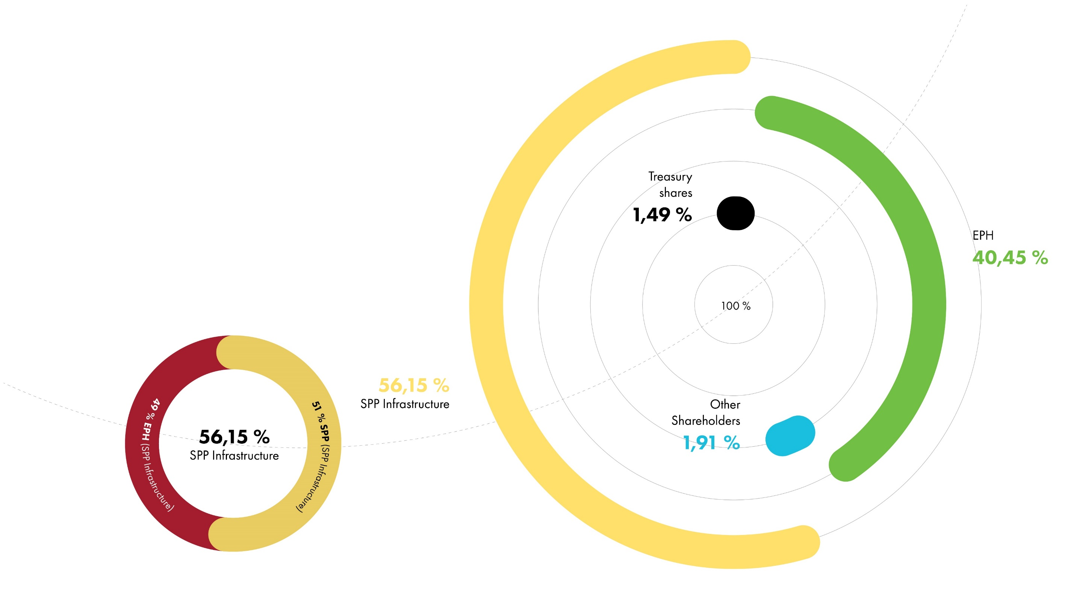
NAFTA / Shareholder structure

Slide 5
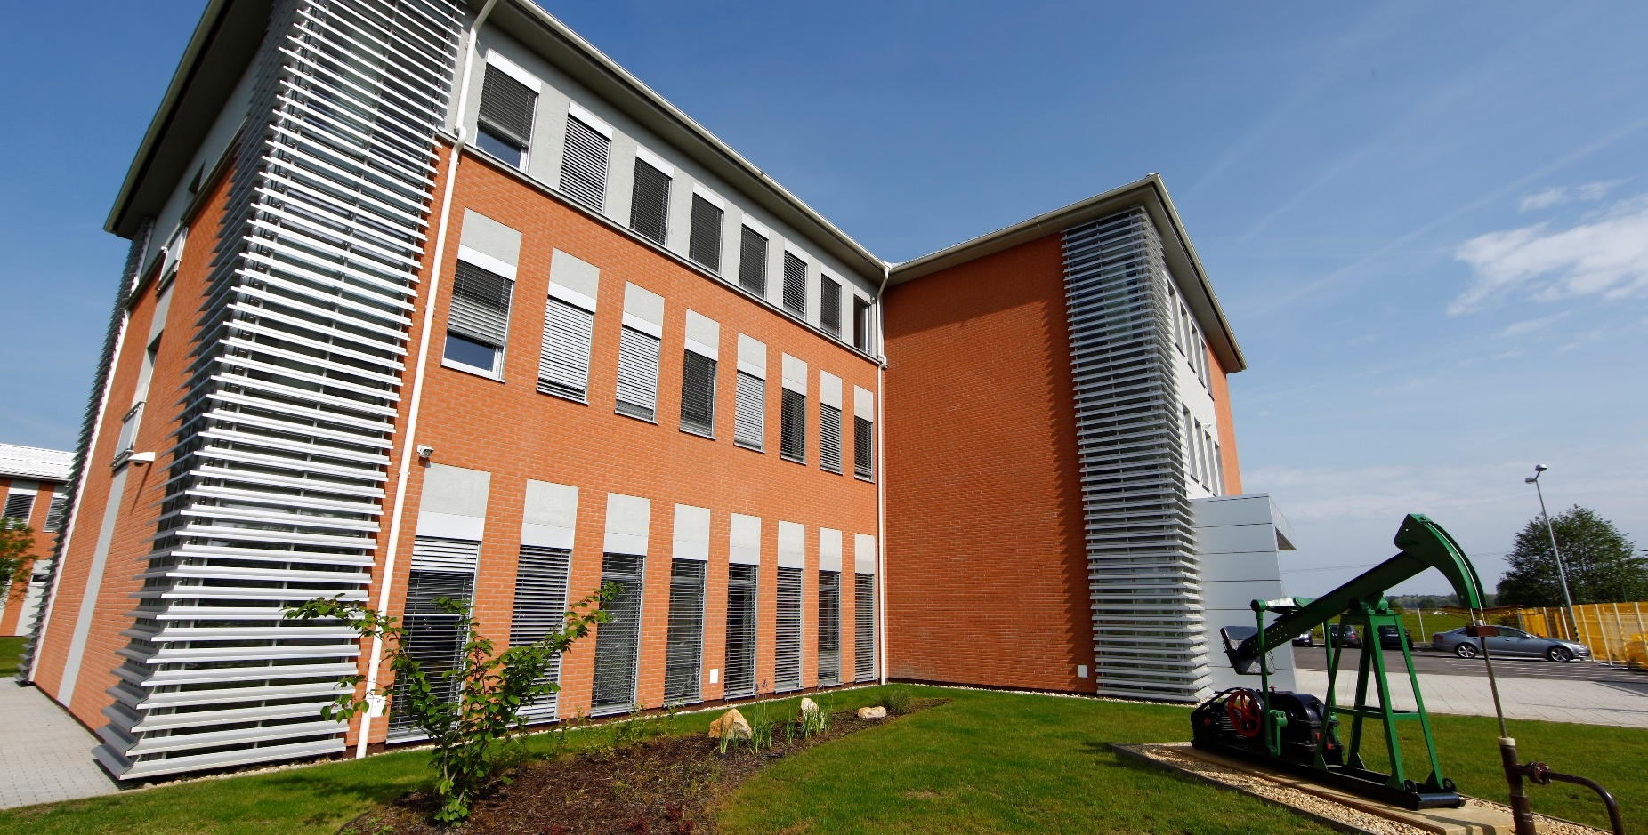
Plavecký štvrtok
Operations and Technology Building

Slide 6
NAFTA / milestones
1913 NAFTA drills Gbely 1 - first well drilled for oil in the Vienna Basin
1914 Start of oil production
1950 Start of industrial gas production
1973 Beginning of underground gas storage operations
1977 Successful exploration of deep pre-Neogene formations
1988 First 3D seismic campaign
2006 Underground storage capacity increases to nearly 2 bcm thanks to geological optimization
2013 EPH become a shareholder of NAFTA via SPP
2014 UGS Gajary-Baden commissioned, working gas volume reaches 2.6 bcm
2015 NAFTA partners with RAG in Underground Sun Storage

Slide 7
Drilling cRew
Photograph from the year 1959

Slide 8
NAFTA / milestones
2016 NAFTA and Cub Energy jointly develop Uzhgorod field in Western Ukraine
2016 NAFTA and Vermilion Energy start Trnava E&P project in Western Slovakia
2018 NAFTA acquires UGS Breitbrunn/Eggstätt, UGS Inzenham-West and UGS Wolfersberg and in Bavaria
2019 NAFTA and Cub Energy started with the first exploration well in Western Ukraine
2019 NAFTA wins Vatazhkivska License tender
2020 NAFTA acquires another opportunities to E&P in Ukraine in two of the PSAs - Grunivska and Okhtyrska
2020 NAFTA started providing technical and advisory services at the Humbly Grove UGS in the United Kingdom
2021 NAFTA purchased the 50% of shares in CNG Holdings Netherlands B.V. and become the sole holder of the Uzhhorod license

Slide 9
CS GAJARY
Central Station UGS in Gajary

Slide 10
NAFTA / ugs operations in europe

Slide 11
NAFTA / ugs operations in central europe
Gas Storage | NAFTA Technical Operator | NAFTA Storage System Operator | NAFTA Technical & Advisory Services | Working Gas Volume (TWh)
UGS Complex Lab | ● | ● |  | 27.7
UGS Pozagas |  |  | ● | 6.9
UGS Dolni Bojanovice |  |  | ● | 6.1
WGV
40.7 TWh
Withdrawal Rate
418.9 GWh/d
Injection Rate
338 GWh/d

Slide 12
Cs GAjary
Central Station UGS in Gajary

Slide 13
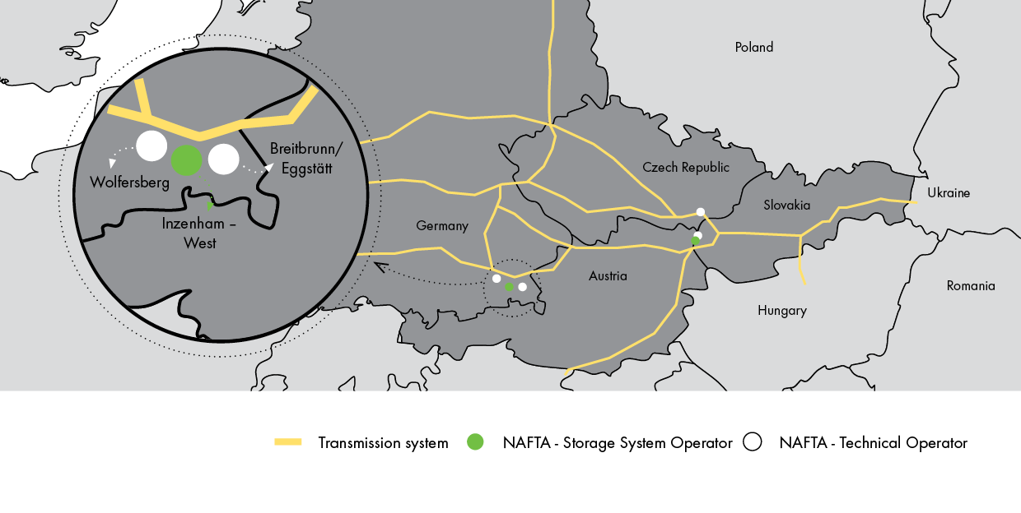
NAFTA / ugs operations in germany

Slide 14
NAFTA / ugs operations in germany
Gas Storage | NAFTA Technical Operator | NAFTA Storage System Operator | Working Gas Volume (TWh)
UGS Breitbrunn/Eggstätt | ● | Uniper Energy Storage | 11.1
UGS Inzenham-West | ● | NAFTA Speicher Inzenham | 4.8
UGS Wolfersberg | ● | Bayernugs | 4.1
WGV
20 TWh
Withdrawal Rate
286 GWh/d
Injection Rate
149 GWh/d

Slide 15
UGS Inzenham-west
UGS of NAFTA Speicher in Germany

Slide 16
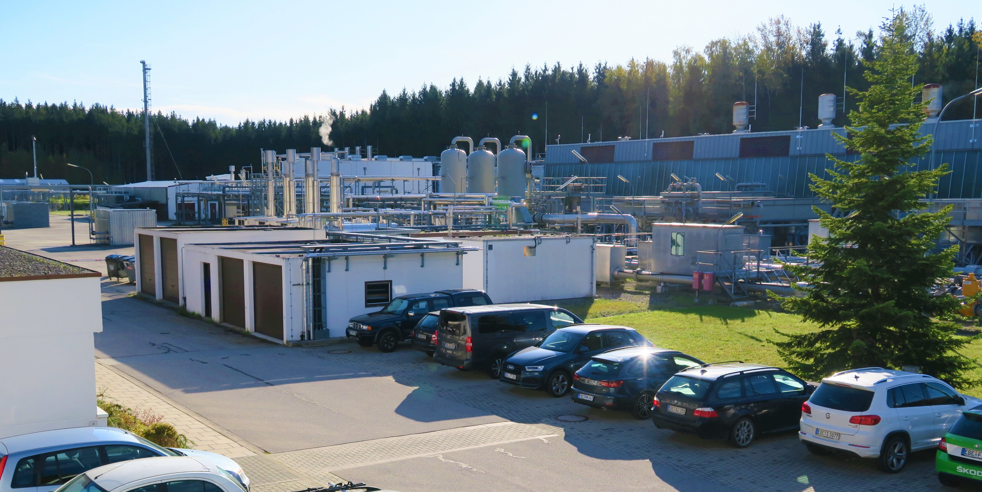
UGS WOLFERSBERG
UGS of NAFTA Speicher in Germany

Slide 17
UGS BREITBRUNN/EGGSTäTT
UGS of NAFTA Speicher in Germany

Slide 18
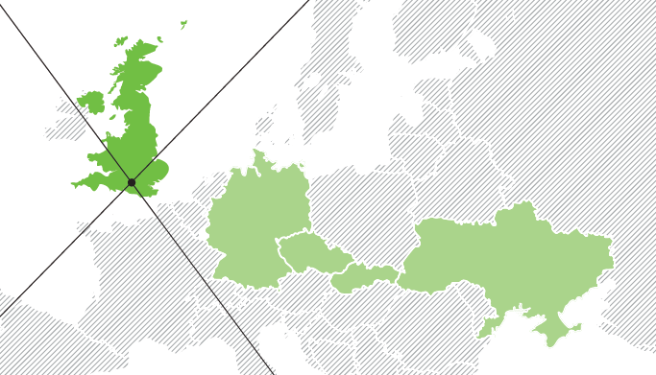
NAFTA / technical & advisory services in UK
WGV
2.6 TWh
Withdrawal Rate
79 GWh/d
Injection Rate
89 GWh/d

Slide 19
UGS humbly grove
UGS in United Kingdom

Slide 20
NAFTA / UGS PRODUCTS & SERVICES
 | SEASONAL STORAGE CAPACITY | FLEXIBLE STORAGE CAPACITY
Customization | ● | ●
Firm or Interruptible | ● | ●
Flat profile | ● | ●
Injection & Withdrawal anytime |  | ●
Multicycling |  | ●
SEASONAL STORAGE CAPACITY
FLEXIBLE STORAGE CAPACITY

Slide 21
CS Gajary
Central Station UGS in Gajary

Slide 22
NAFTA / individual & additional SERVICES
CUSTOMIZATION
additional SERVICES
Additional Working Gas Volume
Extra Injection and Withdrawal rate
Day-ahead rate
Within-day rate
Delivery points switching
Parallel usage of delivery points
Assignment of capacities
Transfer of gas in storage

Slide 23
NAFTA / innovative PRODUCTS
opTION ON STORAGE CAPACITY
Inverse storage
Value-sharing
Get option on storage capacity for the option premium
Decide whether you exercise your option at any time up until the option maturity
Get flexible storage capacity with gas already injected
Ready to trade from day one
Return full storage at the end
Base price equals intrinsic value of storage (summer-winter spread)
Gain extrinsic value from trading gas with flexible storage capacity
Extrinsic value is shared between the parties

Slide 24
CS Gajary
Central Station UGS in Gajary

Slide 25
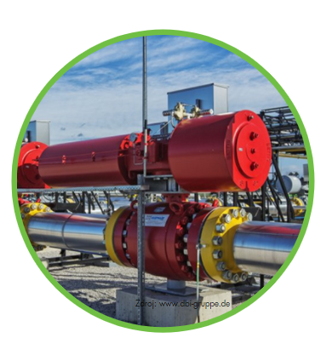
NAFTA / innovative products
FRAMEWORK AGREEMENT
One agreement covers all general contractual matters. For each ensuing storage contract a simple term sheet is enough
Suitable for acquisition of short-term and intra-seasonal capacities

Slide 26
NAFTA / Exploration & Production (e&P)
WELLS DRILLED
3200
DEEPEST WELL
6505 m
DISCOVERIES
57
LICENSE ACREAGE
3 040 km²
3D SEIZMIC
2000 km²
PRODUCTION/YEAR
65 mcm

Slide 27
Záhorská ves
GAS GATHERING STATION

Slide 28
Nafta / PRODUCTION IN Slovakia (mcm/y)
CRUDE OIL
4 560 tons
CONDENSATE
1 570 tons
NATURAL GAS
65.3 mcm

Slide 29
NAFTA in slovakia
Exploration licences obtained in Slovakia

Slide 30
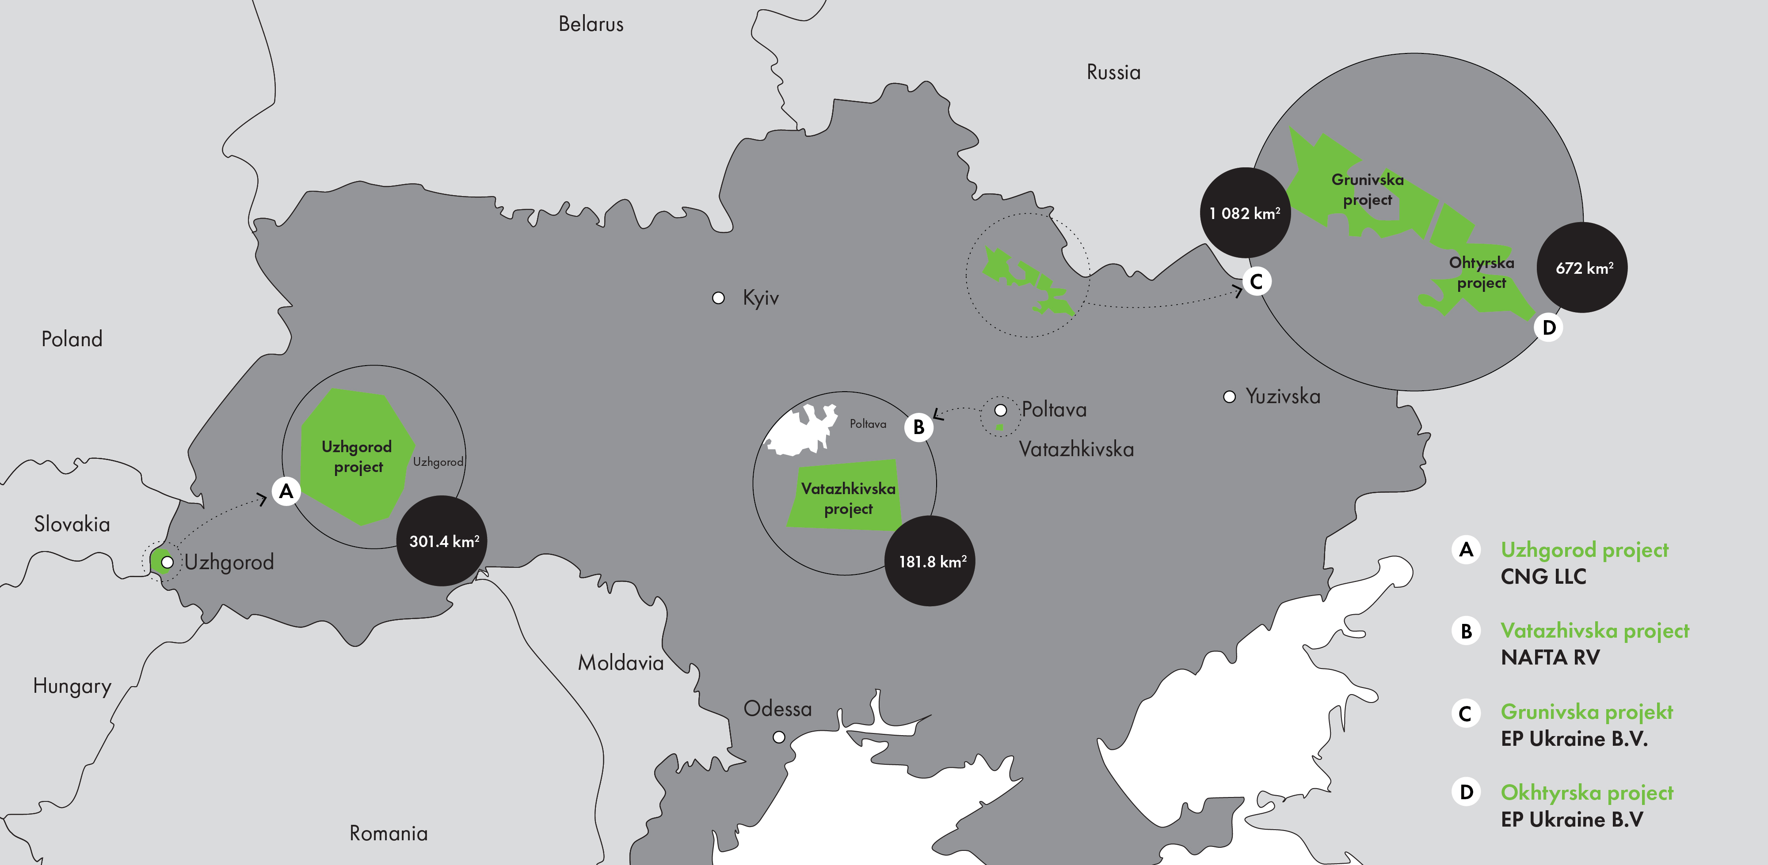
Nafta in ukraine
Exploration licences obtained in Ukraine

Slide 31
NAFTA / green energy innovations
UNDERGROUND SUN STORAGE
First important milestone in our Power2Gas projects in 2014
Partner with RAG (Austria)
Injecting hydrogen/natural gas mixture into a porous reservoir
Completed in 2017
Since then we participated on many innovative projects focused on energy storage and hydrogen

Slide 32
GREEN ENERGY INNOVATIONS

Slide 33
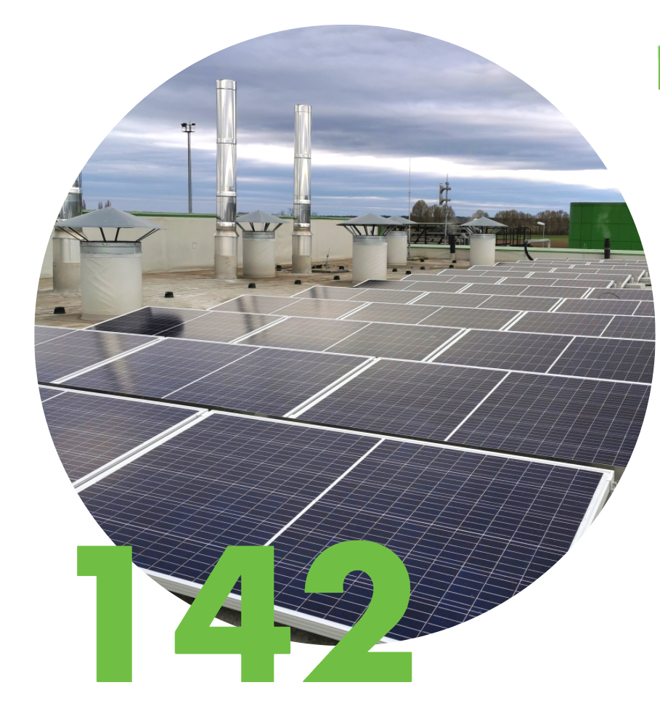
NAFTA / green energy innovations
GAS AND RENEWABLES
Searching and creating synergies with renewables
Participation in professional organizations and platforms for knowledge exchange
Installation of 142 solar panels at facilities in Plavecký Štvrtok and Gajary
P2G and H₂ projects in Slovakia and Germany

Slide 34
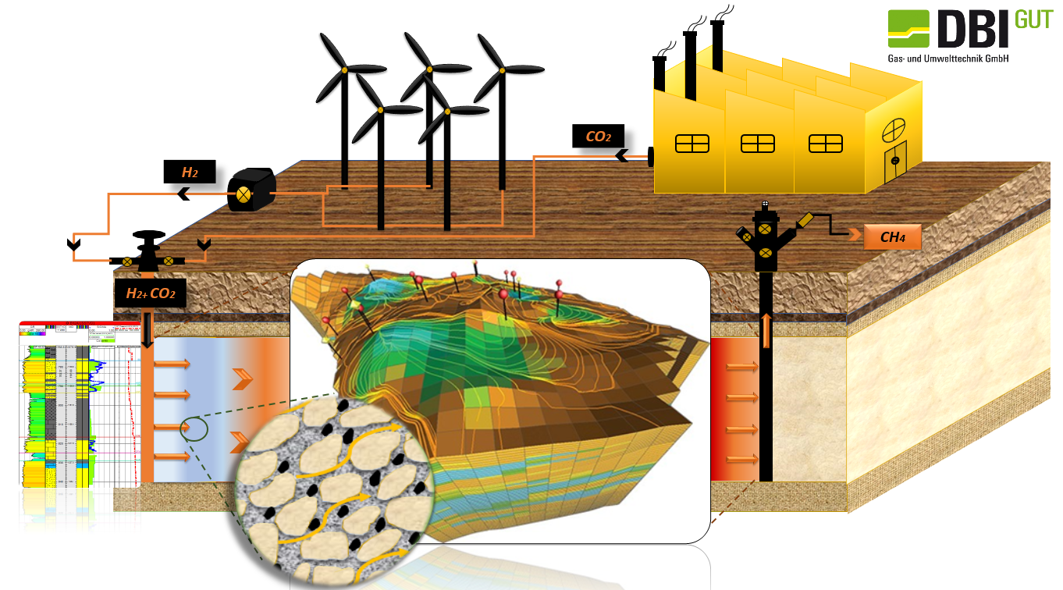
Partner in BIO-UGS
Project of storing Green H₂ and CO₂

Slide 35
NAFTA / DRILLING AND WORKOVER
Well types
Exploration/Production
UGS Injection/Withdrawal
Workover types
Re-completion
Gravel packs
Casing milling
Fleet
Drillmec MR 4000 DB
GVS 3070
BIR 8005
DIR 3009
Engineering services
Well and workover design
Drilling and workover supervision
Drilling and workover services
Both internally and for external customers
ISO 9001, ISO 14001 and ISO 45 001 certifications
Since 2012 workovers done on more than 300 wells
2 crews – 1 drilling and 1 workover
Capable of drilling different types of wells to a depth of 2500 m and performing workovers to a depth of 4000 m

Slide 36
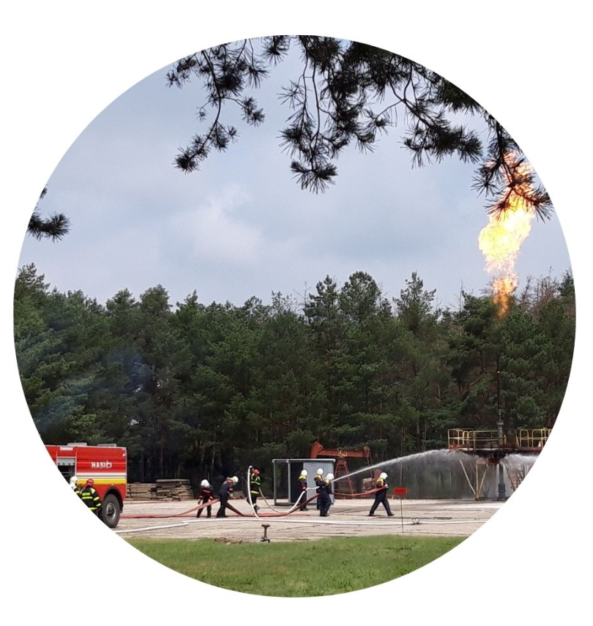
NAFTA / Support service ugs
HBZS – SPECIAL RESCUE UNIT
Unique training facility with "real" gas well
Possibility of various emergency scenarious simulation
Training (smoke) room also for confined space rescue training
Widely used by external (foreign) organisations

Slide 37
Nafta / corporate social responsibility
HSE POLICY
PROCUREMENT POLICY
Governance and Social Policies
By adhering to basic principles of corporate social responsibility is the company minimizing its impact on environment and communities and contributing toward sustainable development. Improving safety at our facilities is our very high priority
NAFTA conducts its commercial activities transparently and operates outstandingly, and the same is expected from our suppliers and contractors.
NAFTA provides reliable services for customers, while acting responsibly towards the community and the environment in which it operates in accordance with applicable European and national legislation.

Slide 38
NAFTA / WE SUPPORT
Green regions
Creating, revitalizing and enhancing green zones and relaxation areas.
Installation of rubbish bins, separating waste produced in these zones or their ecological lighting.
Volunteer events to carry out these generally beneficial activities.

Slide 39
NAFTA / WE SUPPORT
Interactive education
Equipment for schools and classrooms
Access to computer technology and the internet
Innovative educational programs
Excercise and sport activities for children
Physical activities

Slide 40
www.nafta.sk

